Slide 1
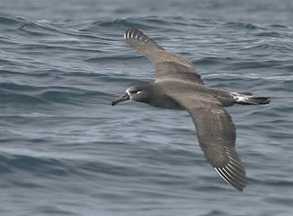
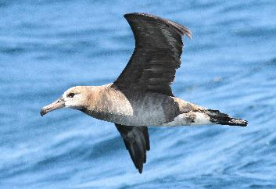

State of the Science and Research Gaps of Environmental Effects of OSW: Collision Vulnerability of Seabirds in the California Current
Presenter: Sharon Hendrix Kramer, PhD
Senior Marine Ecologist
February 28, 2023
Notes:
Session host gives a quick intro (title and authors?), quick company intro—some ideas/text from Laura?

Slide 2
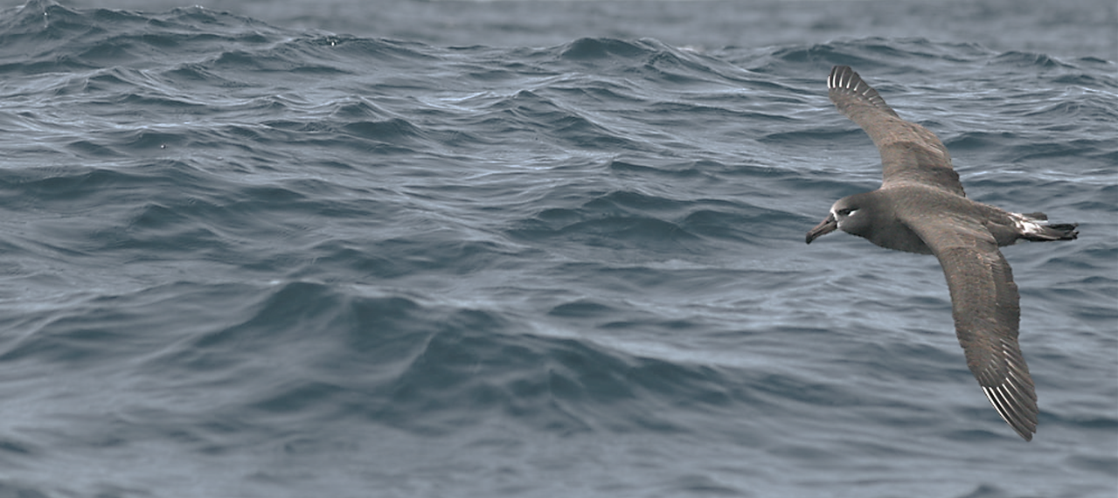
Overview
U.S. west coast vs Atlantic OSW
  Bathymetry
  California Current Ecosystem
  Bird flight behavior
Existing information
Collision vulnerability model
Information learned from new monitoring technology
Notes:
Bathymetry is very different where west coast projects are going, versus in the Atlantic
Seabird species differs as well, in the EU many migrants flying between land masses, and seabirds that may not travel as great distances as off the west coast, where many birds nest in places like HI, NZ, etc. and come to the California Current to take advantage of high productivity.

Slide 3
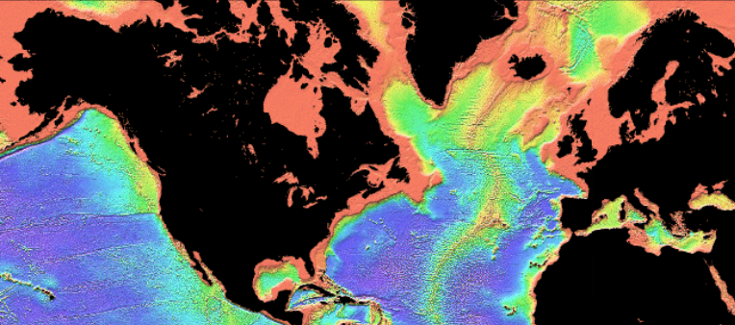
Offshore Wind and Seabirds in the Pacific
Image Credit: NOAA

Slide 4
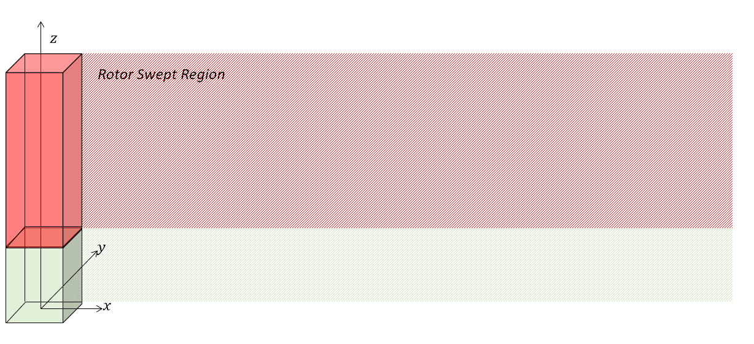
Offshore Wind and Seabirds in the Pacific
200 m
Rotor Swept Region
30 m
0 m
Schatz Energy Research Center
H. T. Harvey & Associates

Slide 5
Seabird Abundance Data

Slide 6
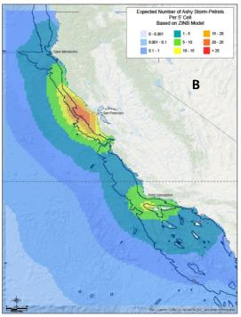
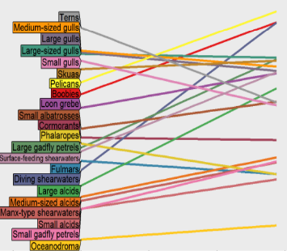
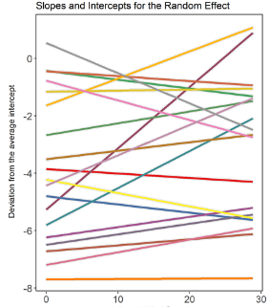
3D Vulnerability Framework
2D species maps
Seabird Observations
Species 1
Species 2
Many types of seabirds with varying flight height responses to wind speed
Oceanographic Conditions
Species i
Functional Relationship between Wind Speed and Seabird Flight Height
3D Seabird Vulnerability Model
Ford et al. 2020
Ford et al. 2020
R. G. Ford Consulting Company
H. T. Harvey & Associates
Offshore Wind Speed Data
NREL WindToolKit (2000-2019)
Wind Speed (m/s)

Slide 7

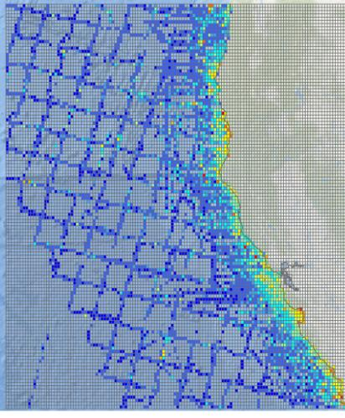
Results: Seabird Abundance Data
Total Seabird Density
Birds per km²
  Nearshore versus offshore patterns
    Abundance (and diversity) maximized in coastal areas
  Nearshore
    Many species nest in CA
    All nesting colonies except for the Farallon Islands are within 5 miles (8 km) of the coastline
  Offshore
    Many species do not nest in CA
    Long distance migrants in search of food outside of the nesting period
  Changes through time – “seabird seasons”

Slide 8
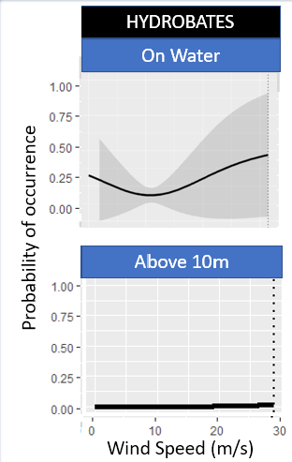
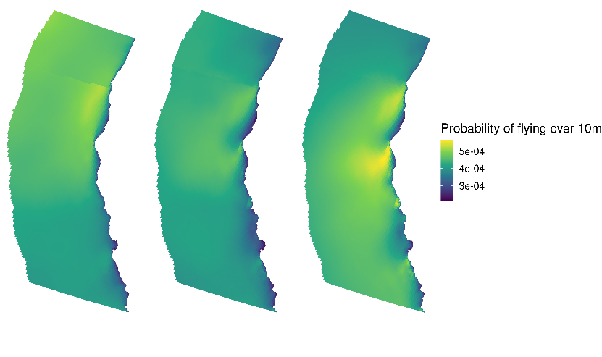
Results: Seabird Flight Height Data
Davidson
Oceanic
Upwelling

Slide 9
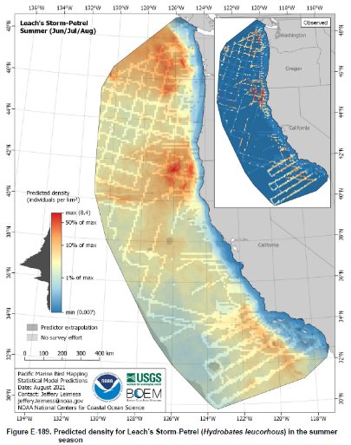
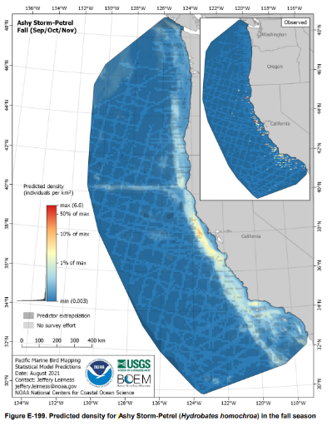
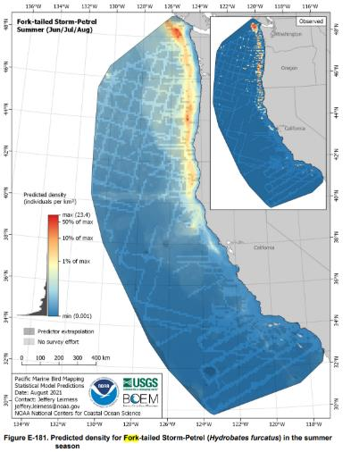
Results: Application to Current 2D Maps
Map from OCS Study BOEM 2021-014 (Lierness et al. 2021)

Slide 10
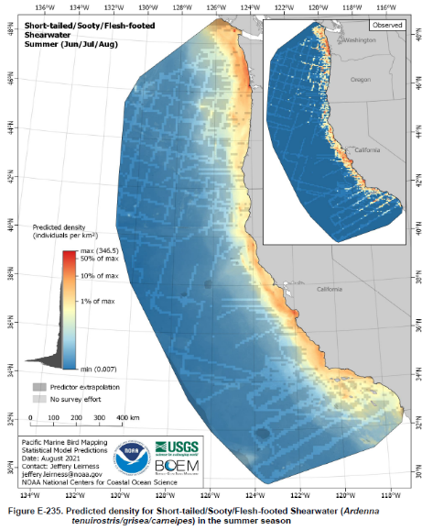
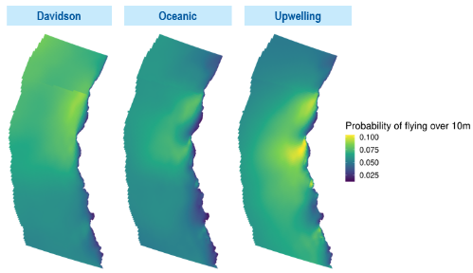
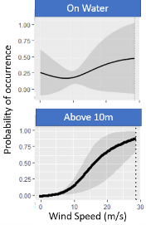
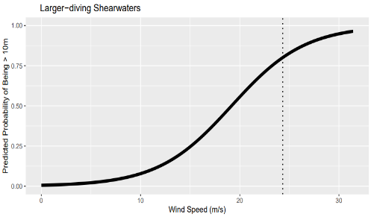
Results – Application to Current 2D Maps
Map from OCS Study BOEM 2021-014 (Leirness et al. 2021)

Slide 11
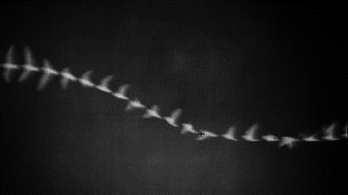
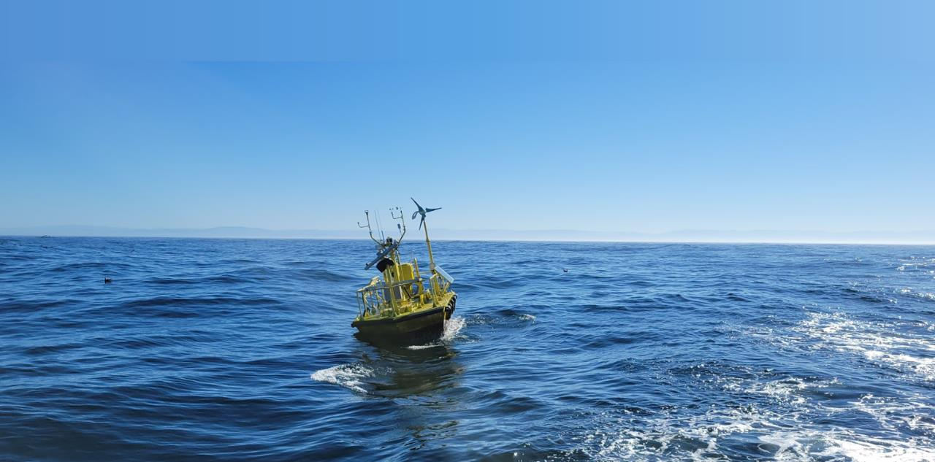
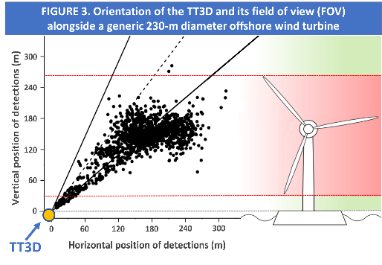

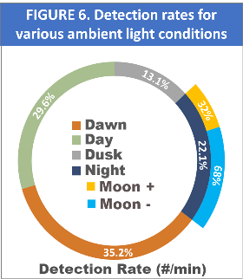
Thermal Tracker 3D
H. T. Harvey & Associates

Slide 12
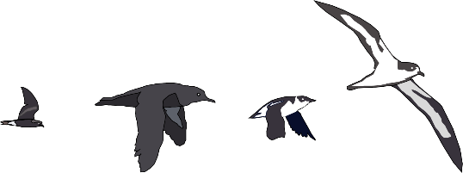

Thank you!
Acknowledgements: Stephanie Schneider, Sophie Bernstein, Scott Terrill, David Ainley, Jarrod Santora, Lisa Balance
R.G. Ford Consulting: Glenn Ford, Janet Casey
PNNL: Shari Matzner
Cal Poly Humboldt SERC: Arne Jacobsen, Eli Wallach, Charles Chamberlain
California Energy Commission: David Stoms
Sharon Kramer, PhD
skramer@harveyecology.com
www.harveyecology.com

